Slide 1

Analysis of NFL Injuries
Drew Brinda

Slide 2
Datasets
The datasets I will be using are from Kaggle by the National Football League. There are these 3 different datasets:
Injury Record Dataset: Contains information on 105 lower-limb injuries that occurred during regular season games over two seasons on a team.
Play List Dataset: Details about the game and play include the player’s assigned roster position, stadium type, field type, weather, play type, position for the play, and position group.
Player Track Dataset: Player level data that describes the location, orientation, speed, and direction of each player

Slide 3
Goal
The problem I am trying to assess is examining the effects that playing on synthetic turf versus natural turf can have on player movements and the factors that may contribute to lower extremity injuries. I will be comparing different factors like part of the body that was injured, number of days out with injury, roster position of injured player, stadium type, temperature, and weather.

Slide 4
Data Cleaning
Went through an examined each dataset to see what values needed cleaning through Python.
Example: Combining similar values for a specific weather type for a game. Changing Outdoors to Outdoor value as well as other misspellings in the dataset.
Similarly did the same with the weather values.
Temperature -99 values had to change to “No Temp”

Slide 5
Exploratory Data Analysis
After the data cleaning stage, I imported my three cleaned datasets to start exploring through different functions.
Joined Injury Record dataset and Play List dataset on Play Key id to see common characteristics of why players were getting injured.
Also, examining each dataset to see counts of values and different mean, median, range numbers.

Slide 6
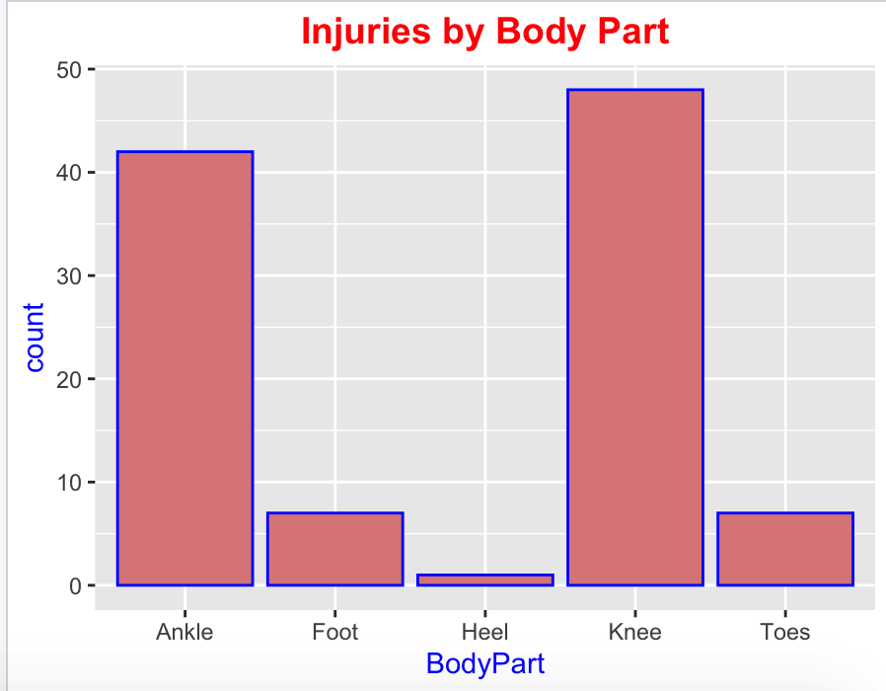
Visualization Model
Injuries by Body Part

Slide 7
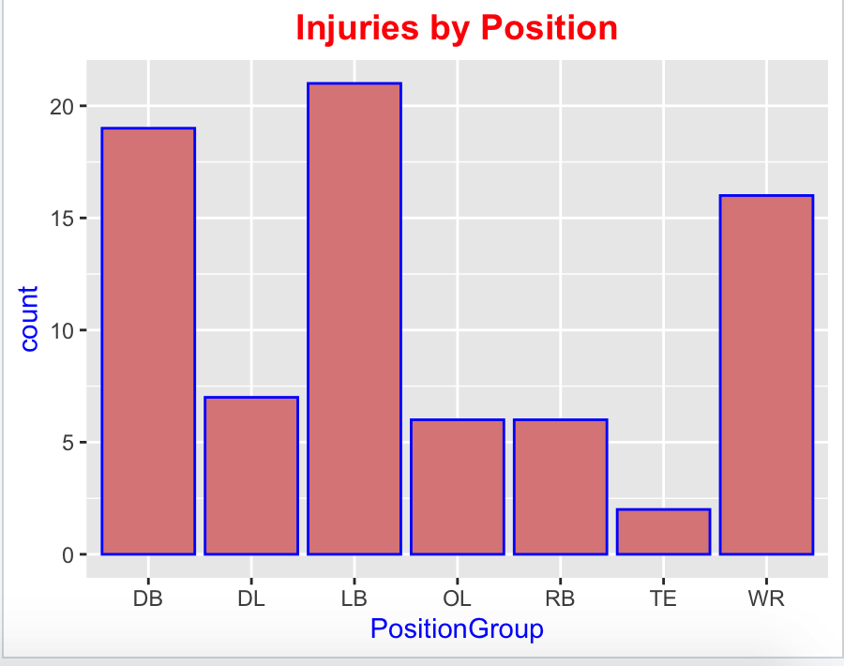
Visualization Model
Injuries by Position

Slide 8
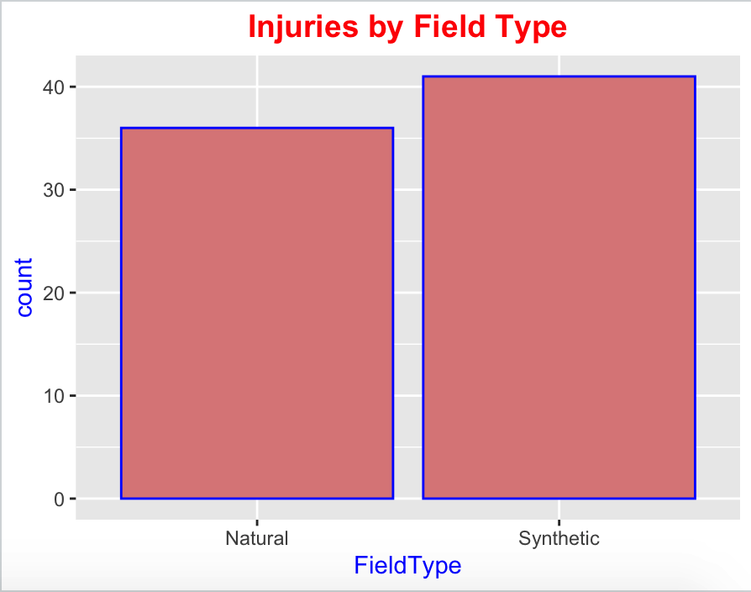
Visualization Model
Injuries by Field Type

Slide 9
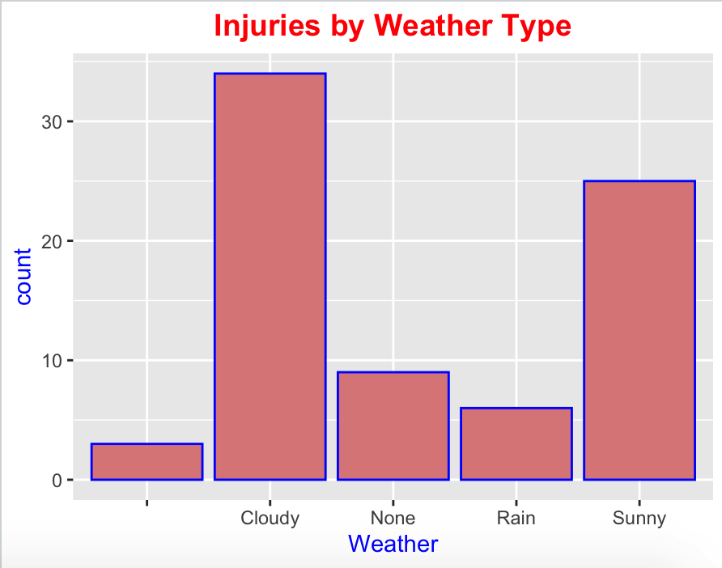
Visualization Model
Injuries by Weather Type

Slide 10
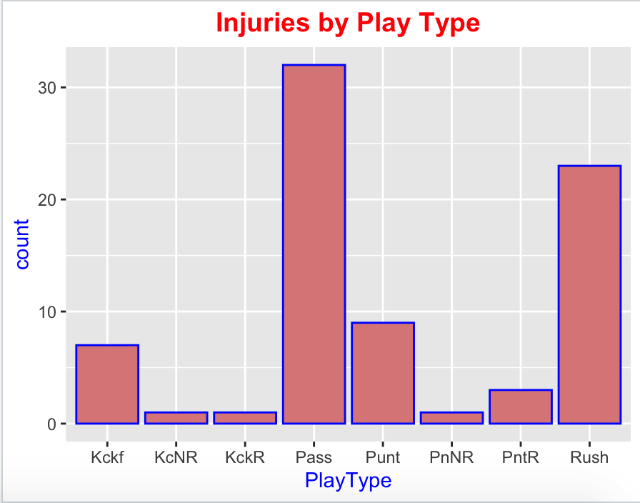
Visualization Model
Injuries by Play Type

Slide 11
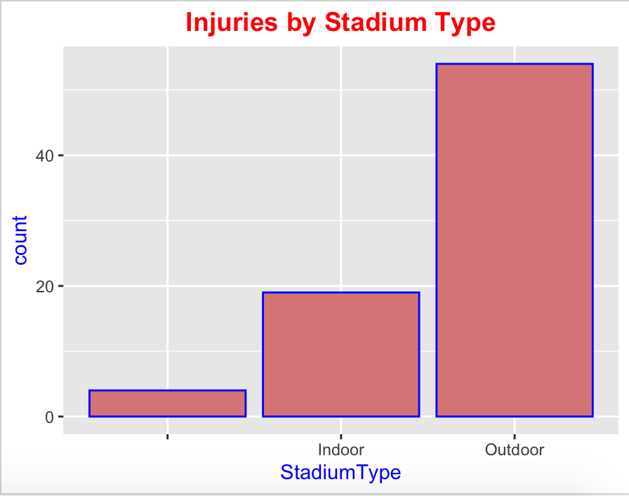
Visualization Model
Injuries by Stadium Type

Slide 12
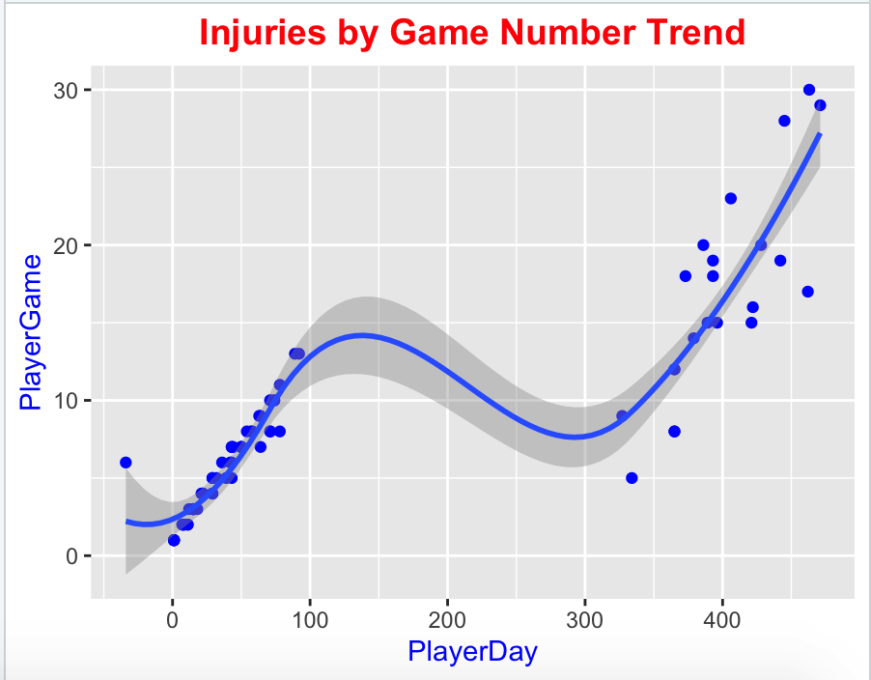
Visualization Model
Injuries by Game Number with trend

Slide 13
Conclusion
Throughout these visualizations we can see the major trends of why injuries have been occurring on this one team for the last 2 seasons.
There are many different factors to consider when trying to determine the most key one.
I hope my analysis by comparing the key variables gives a starting place of how to reduce injuries.

Slide 14
References
NFL 1st and Future - Analytics. https://kaggle.com/c/nfl-playing-surface-analytics. Accessed 7 Oct. 2021.
“Free Football Player PowerPoint Template.” Free PowerPoint Templates, 4 June 2018, https://www.free-power-point-templates.com/free-football-player-powerpoint-template/.

